Slide 1
Power Automate - Power User Module 2 – Triggers & Actions
Sheldon Ledbetter Principle Customer Engineer

Slide 2

Objective
Understand how to use Triggers and Actions in Power Automate

Slide 3
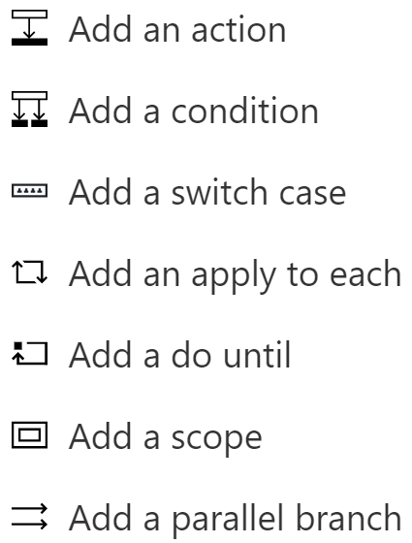
Flow design

Slide 4
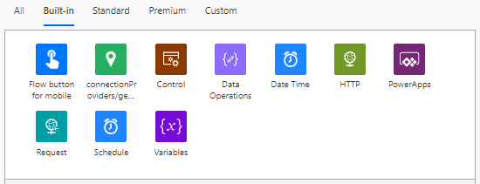
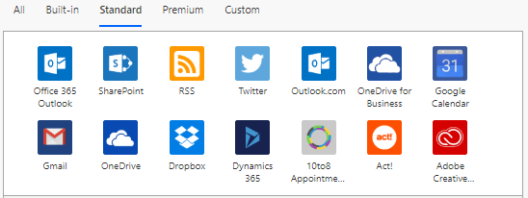
Triggers
Notes:
Talking points:
A trigger is an event that starts your flow. It utilizes a connector.
Each flow can only have one trigger.
Some common triggers are:
1. Buttons
2. Automated trigger
When a new email arrives
When an item is created (in a SharePoint Online list)
When a feed item is published (in an RSS feed)
When a file is created (OneDrive)
When a new tweet is posted
HTTP/Webhook
3. Schedule/recurrence trigger

Slide 5
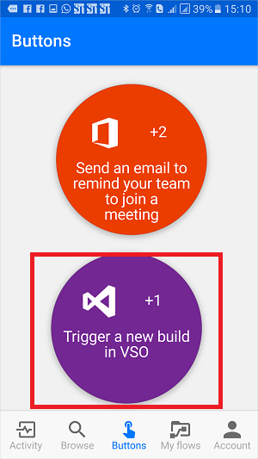
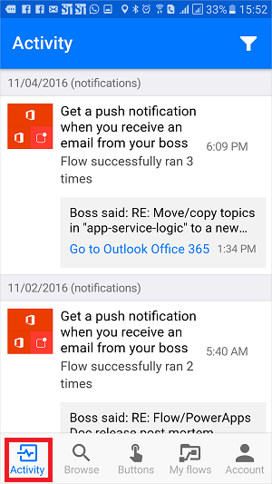
Button flows
Allows you to easily run repetitive tasks from any place, at any time via your mobile device.
Note: you can create a button flow from any device, but you can only run button flows from the Flow app.
Launch Power Automate app on your mobile device.
Click on the buttons tab at the bottom of the screen and then choose the flow you wish to trigger.
You can also monitor the activity/progress of the button flow in the mobile app.
Notes:
Talking points:
There are many repetitive tasks that we all wish we could run with just a tap of a button. For example, you may need to quickly email your team to remind them to join the daily team sync. Button flows allow you to accomplish these and many other tasks simply by tapping a button on your mobile device.
You have full control of your button flows so you can enable/disable, edit or delete a button anytime, anyplace. From the mobile app or from the flow portal, select My flows to get started managing your flows….review on phone.
Note:
All run history is deleted when you delete a flow.
Tap Update after you are done editing a button flow, to save your changes.
If you disable a flow, it will no longer be available on the Buttons tab
Documentation:
https://docs.microsoft.com/en-us/flow/introduction-to-button-flows

Slide 6
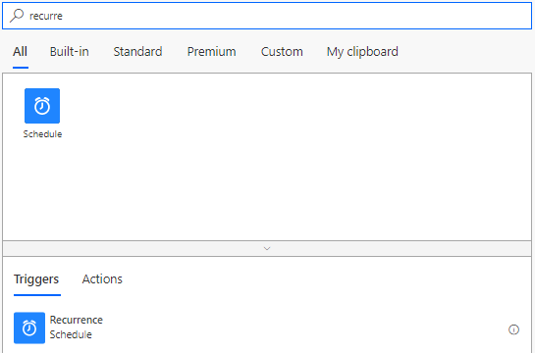
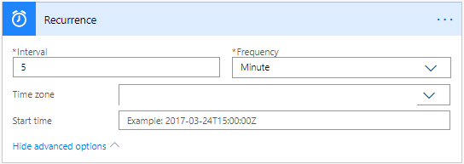
Recurrence - schedule
If you want to run your flow on a schedule, you can select the Schedule connector with the Recurrence trigger.
Specify how many times you want it to run per time period, and optionally specify the time zone and start time.
Notes:
Documentation :
https://docs.microsoft.com/en-us/flow/run-scheduled-tasks#create-a-recurring-flow

Slide 7
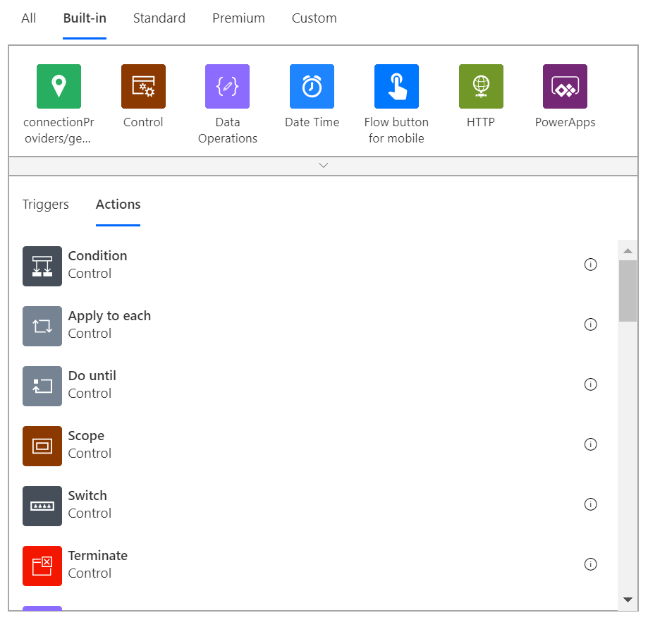
Actions
Notes:
Talking points:
An action is an event that carries out the change/performs the duty to make your flow useful. It also utilizes a connector.
Point out that multiple triggers and multiple actions can correspond to a single connector.
There are often multiple actions per flow, and they follow a trigger.
You can’t start a Flow with an action.
Common actions will notify, modify, create, delete, or calculate something
There are also several controls which are a subcategory of actions.
These include conditions, Apply to each, Do until, Scope, Switch, or a parallel branch, which we will talk about later.
Documentation :
https://docs.microsoft.com/en-us/flow/multi-step-logic-flow

Slide 8
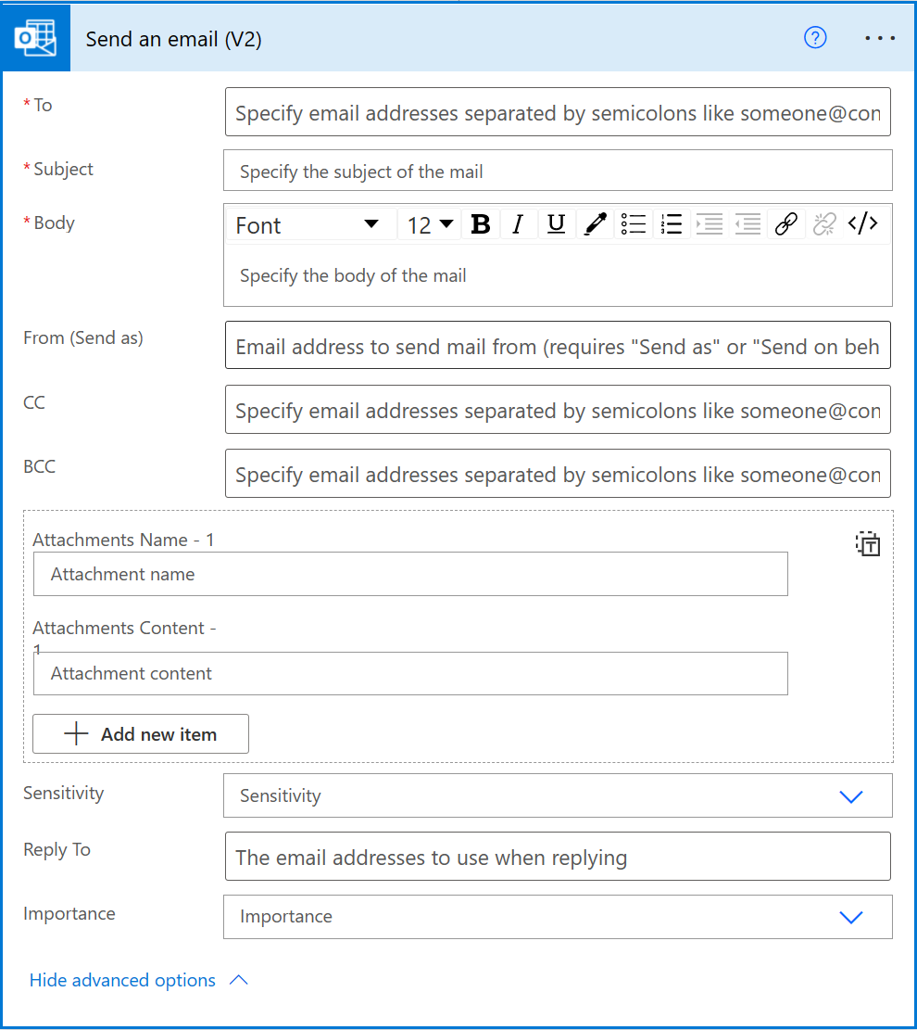
Case study of actions: Outlook
There are several actions for the Office 365 Outlook connector, which give the ability to create, delete, export, flag, mark, get, move, reply, send, and update Outlook items:
These Outlook items include mail items, as well as contacts, calendar events, attachments and more.
One such action is to “Send an email.”
Here is the expanded view of the action, which includes the ability to send as/on behalf of, as long as the user has proper permissions.
Notes:
Documentation :
To use this integration, you will need access to an O365 mailbox that has the REST API enabled.
There are throttling limits per mailbox: https://developer.microsoft.com/en-us/office/blogs/throttling-changes-coming-to-beta-outlook-apis-and-outlook-related-apis-in-microsoft-graph/
Send on behalf of (how to grant permissions): https://docs.microsoft.com/en-us/office365/admin/add-users/give-mailbox-permissions-to-another-user?redirectSourcePath=%252farticle%252fSend-email-from-another-user-s-mailbox-in-Office-365-2B828C5F-41AB-4904-97B9-3B63D8129C4E&view=o365-worldwide#send-email-from-another-users-mailbox

Slide 9
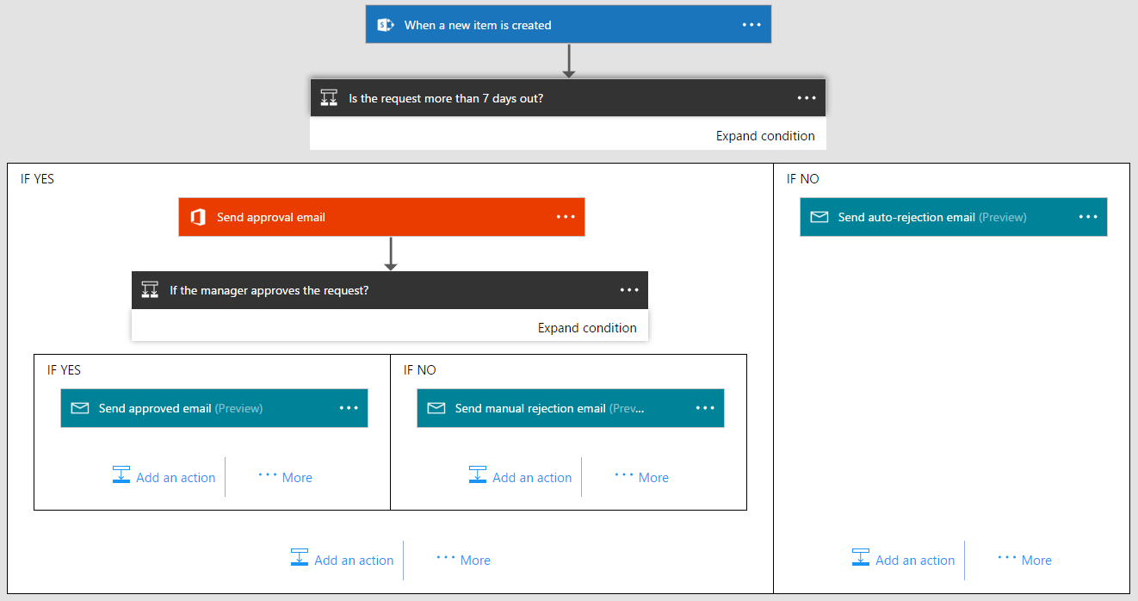
Use Conditions to make logic
Support for nested condition
Notes:
Talking points:
You can specify that a flow performs one or more tasks only if the condition is met.
You can specify an expression in your conditions. Logical expressions include the following operators:
And, or, equals, less, lessOrEquals, greater, greatOrEquals, empty, not, if
You can also use more than one expression, such as “If a parameter equals [X value or Y value]”
This allows you to check multiple values in your condition. In the example above, you are checking X value and Y value.
There is support for nesting conditions
Documentation :
https://docs.microsoft.com/en-us/flow/add-condition
https://docs.microsoft.com/en-us/flow/use-expressions-in-conditions

Slide 10
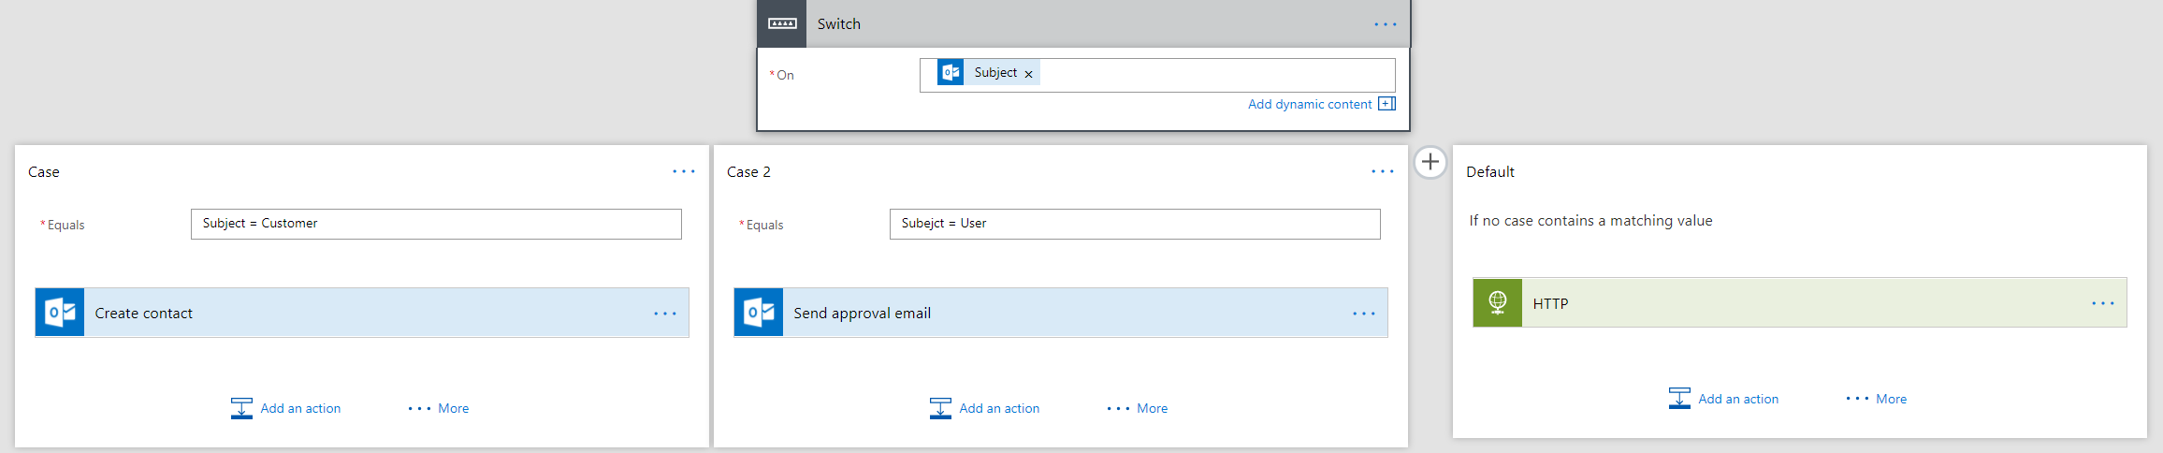
Use Switch Case to have multiple conditions
Notes:
Talking points:
Switch blocks allow you to have multiple conditions
Documentation :
https://flow.microsoft.com/en-us/blog/build-advanced-flows/

Slide 11
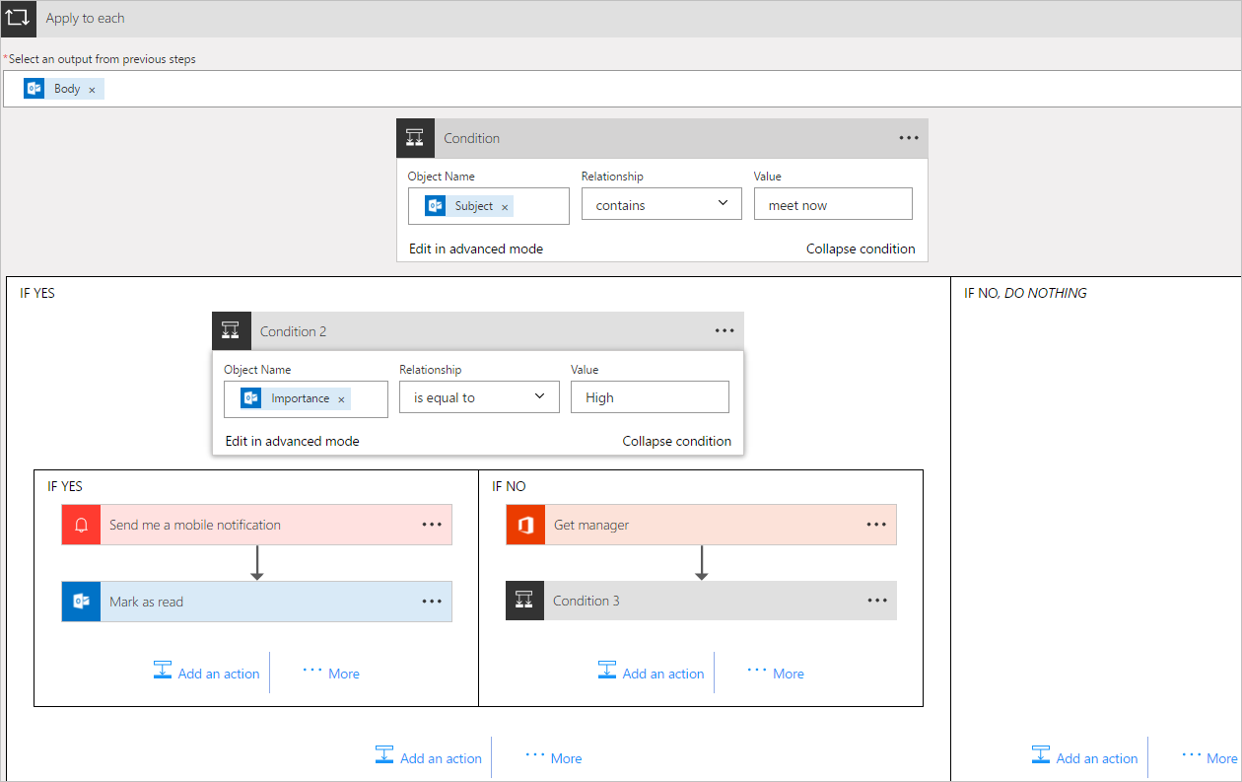
Use Apply to each action to process a list of items
Notes:
Talking points:
When you use the apply to each control, you will have to choose an output from the previous step, for which the future actions will apply to.
Documentation :
https://docs.microsoft.com/en-us/flow/apply-to-each

Slide 12
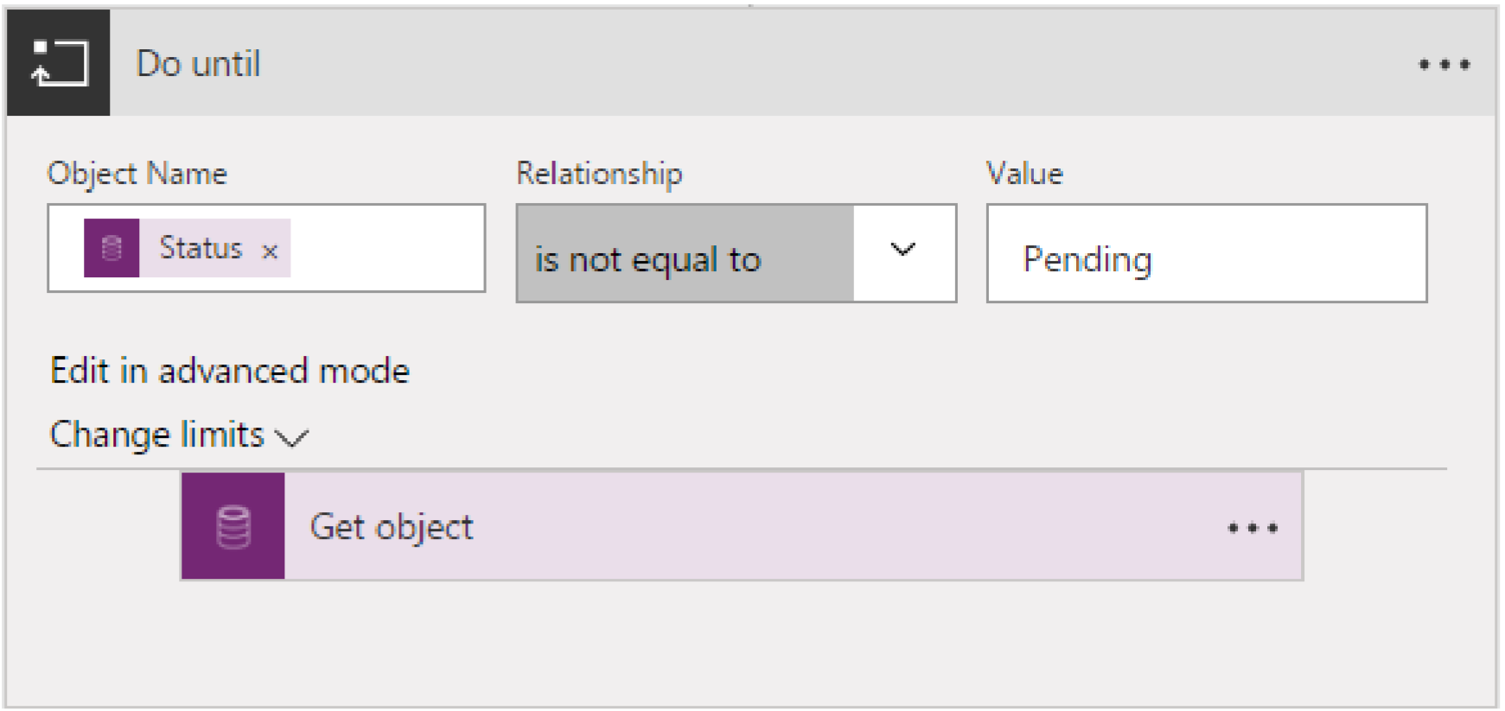
Use Do until for looping
Notes:
Talking points:
Do until makes the flow repeat a step until a certain condition is met. This is often used in approval scenarios.

Slide 13
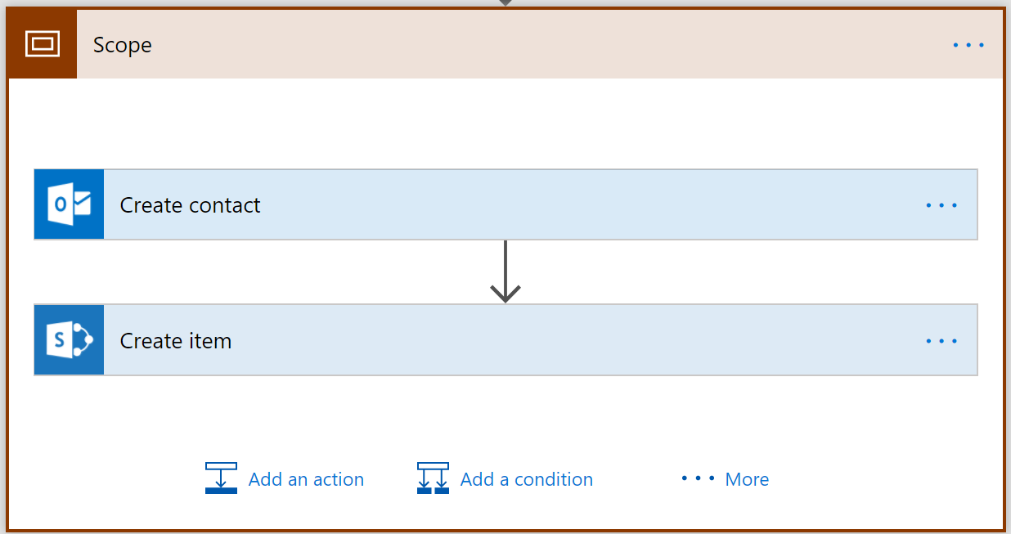
Use a Scope to group two or more actions together
Also, an easy way to move actions around
Notes:
Talking points:
Scopes allow you to visually collapse the actions inside of them. Think of scopes as an organizational control.
Remember you can change the name of the scope.

Slide 14
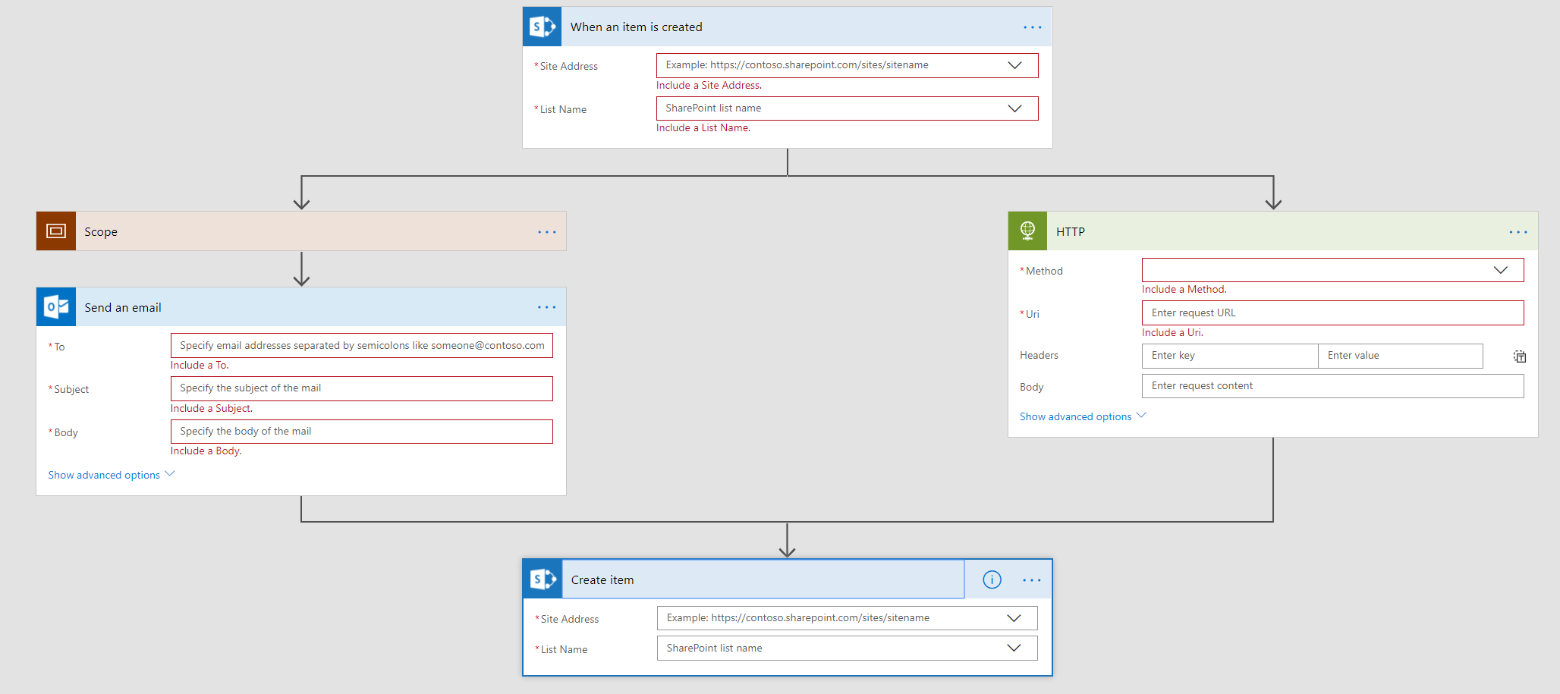
Run in Parallel: two or more steps that run at the same time
Notes:
Talking points:
You will only see this option when you add a new step underneath an action (not a trigger).
Documentation :
https://flow.microsoft.com/en-us/blog/parallel-actions/

Slide 15
Follow along
In this module the training is hands-on….
Follow along

Slide 16
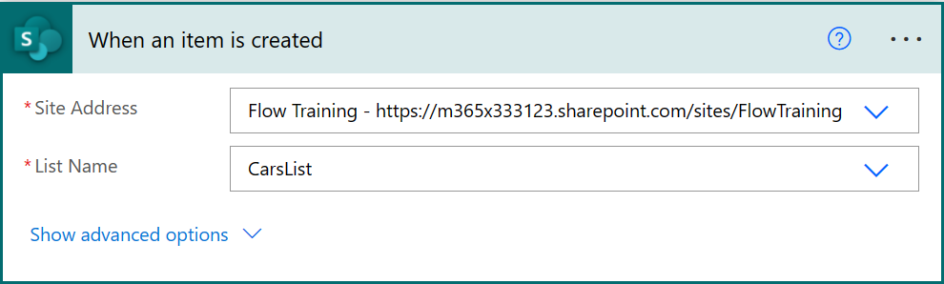
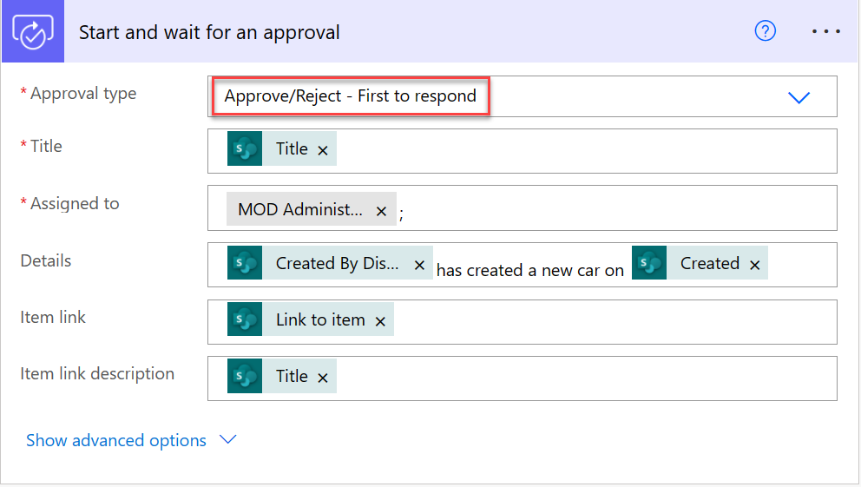
Lab 1 - Use Approval Flows to send and manage approvals
Follow along
Create new “Automated cloud flow” named “Carlist approval” and select “When an item is created“ trigger
Add action "Start and wait for an approval“ using values like in the screenshot right. Use your own O365 email address
Title: [Title] (dynamic content from “When an item is created”)
Assigned to: Your O365 account
Details: [Created by Display Name] has created a new car on [Created] (dynamic content from “When an item is created”)
Item link: [Link to item] (dynamic content from “When an item is created”)
Item link description: [Title] (dynamic content from “When an item is created”)
Notes:
Once done
First click Flow Checker at top right to ensure no errors and all required fields have been filled out
Click Save​
Click Test and select Manually
Go to FlowTraining SharePoint site https://YOURTENANTNAME.sharepoint.com/sites/FlowTraining
Open CarsList and add new item to the list
Come back to Flow and check that it is triggered. At this point you should be waiting for approval
Open your mail at https://outlook.office.com in another tab of the browser and approve the new item in the list that you just created​
Approve the new item you just created to CarsList. Notice that there is also a link to SharePoint list item in the Approval email
You should receive an email notifying you that the item has been approved
Documentation :
https://docs.microsoft.com/en-us/flow/modern-approvals

Slide 17
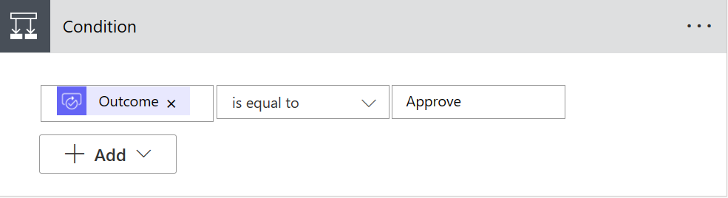
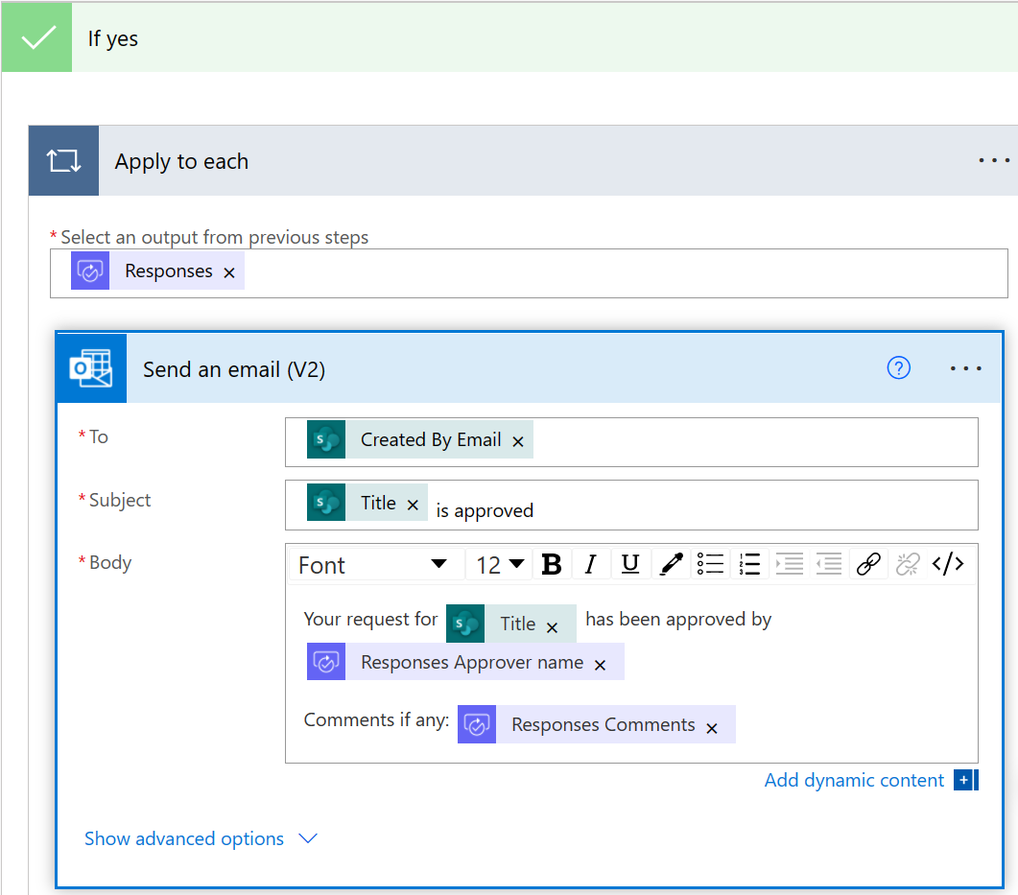
Lab 1 - Use Approval Flows to send and manage approvals
Follow along
4. Add Condition action -> [Outcome] “is equal to” Approve
5. Add “Send an email (V2)” actions to “If yes” condition
To: [Created by Email] (dynamic content from “When an item is created”)
Subject: [Title]is approved
Body: Your request for [Title] has been approved by [Response Approver name] Comments if any: [Responses Comments]
NOTE! You do not have to add Apply to each manually as it will be automatically added when you add Responses Approver name / comment dynamic content to Send an email body field
Notes:
Once done
First click Flow Checker at top right to ensure no errors and all required fields have been filled out
Click Save​
Click Test and select Manually
Go to FlowTraining SharePoint site https://YOURTENANTNAME.sharepoint.com/sites/FlowTraining
Open CarsList and add new item to the list
Come back to Flow and check that it is triggered. At this point you should be waiting for approval
Open your mail at https://outlook.office.com in another tab of the browser and approve the new item in the list that you just created​
Approve the new item you just created to CarsList. Notice that there is also a link to SharePoint list item in the Approval email
You should receive an email notifying you that the item has been approved
Documentation :
https://docs.microsoft.com/en-us/flow/modern-approvals

Slide 18
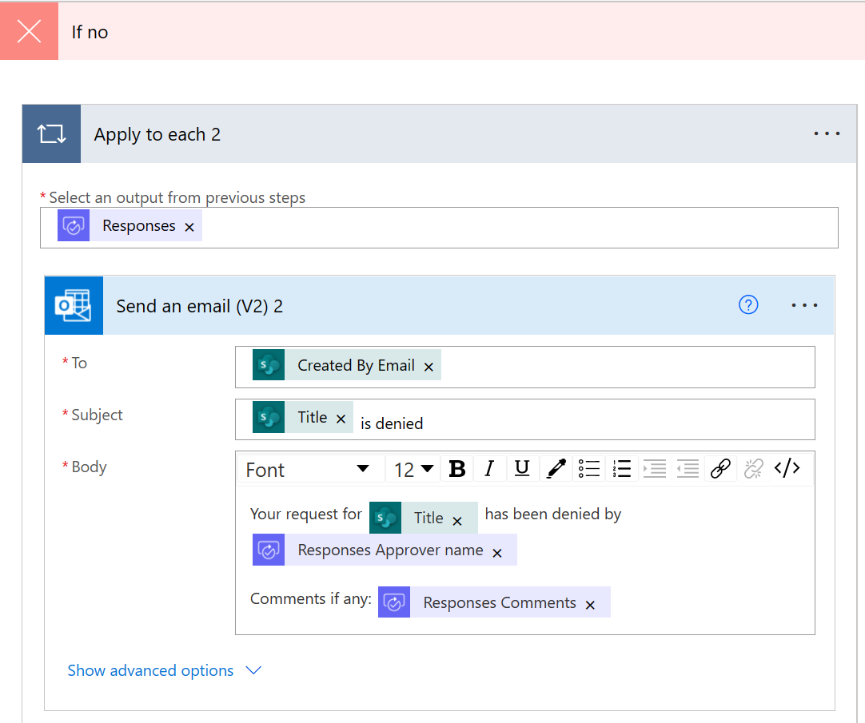
Lab 1 - Use Approval Flows to send and manage approvals
Follow along
6. Copy “Apply to each” and paste it to “If no” condition
To: [Created by Email] (dynamic content from “When an item is created”)
Subject: [Title]is denided
Body: Your request for [Title] has been denied by [Response Approver name] Comments if any: [Responses Comments]
NOTE! You do not have to add Apply to each manually as it will be automatically added when you add Responses Approver name / comment dynamic content to Send an email body field
7. Save and test the Flow by selecting “Manually”
8. Create new item to CarsList and open your Outlook email to see approval email to be sent
Notes:
Once done
First click Flow Checker at top right to ensure no errors and all required fields have been filled out
Click Save​
Click Test and select Manually
Go to FlowTraining SharePoint site https://YOURTENANTNAME.sharepoint.com/sites/FlowTraining
Open CarsList and add new item to the list
Come back to Flow and check that it is triggered. At this point you should be waiting for approval
Open your mail at https://outlook.office.com in another tab of the browser and approve the new item in the list that you just created​
Approve the new item you just created to CarsList. Notice that there is also a link to SharePoint list item in the Approval email
You should receive an email notifying you that the item has been approved
Documentation :
https://docs.microsoft.com/en-us/flow/modern-approvals

Slide 19
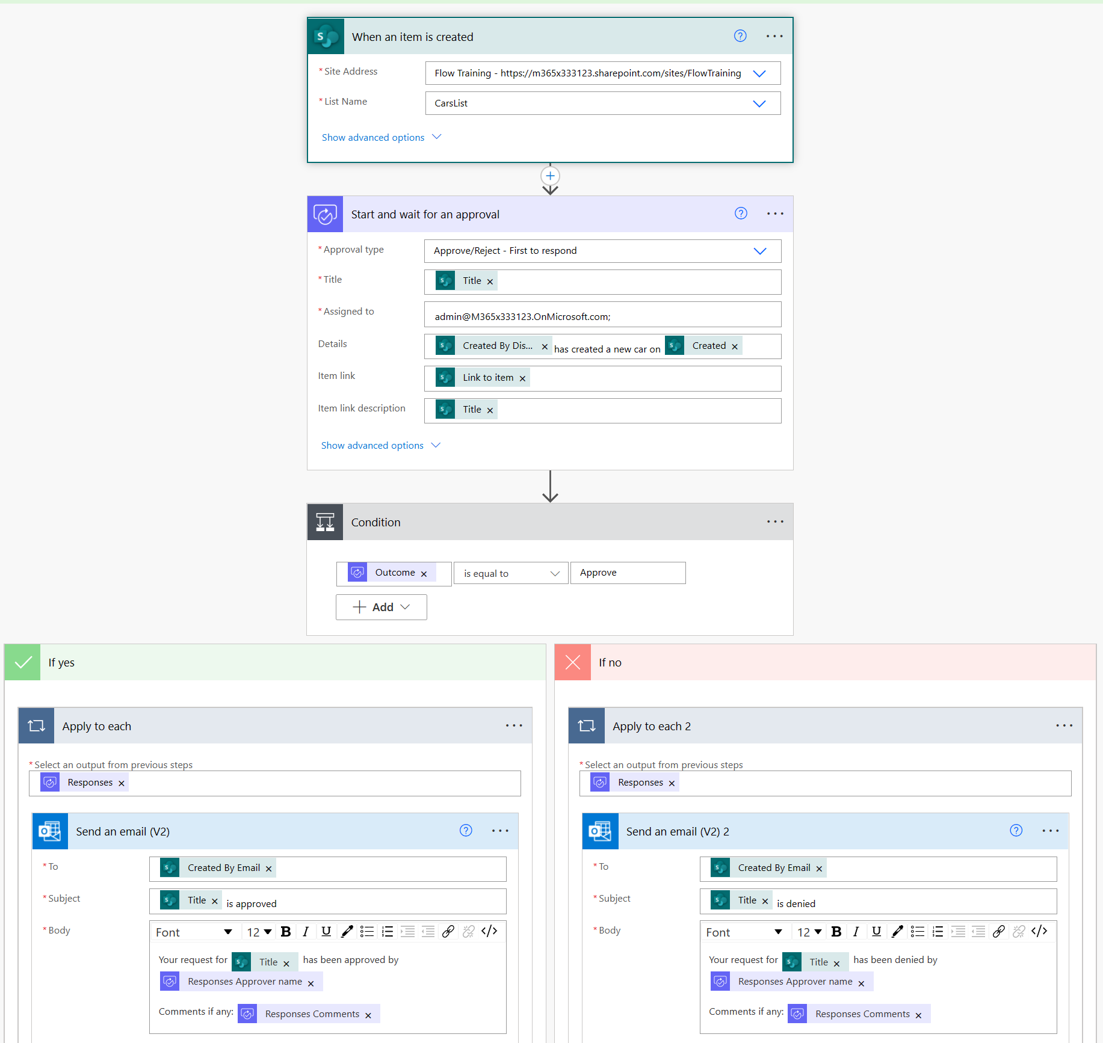
Lab 1 - Use Approval flows to send and manage approvals
Follow along
Notes:
Follow along steps:
1. Click on My flows at https://flow.microsoft.com after signing into your Tenant
2. Click New | Automated-from blank
3. Name the Flow "Carlist Approval"
4. Select "When an item is created" (SharePoint) from the list
6. Click Create
7. In Site Address, click on drop down to select FlowTraining site
8. In the List Name, click on drop down to select CarList list
9. Click "New Step"
10. Type "approval" and then select "Start and wait for an approval"
11. In Approval type, click drop down box and select "Approve/Reject - First to respond"
12. Put "Please review:" in the Title field and then add Title, Dynamic Content
13. Add your mailbox to the Assigned To field
14. Add additional Dynamic Contents per screenshots above
15. Do the same per screenshot above for If Yes and If No by adding Send an email action to both. Note: The "Apply to each" will be automatically created for you after you put in dynamic actions per the screenshot above.
If Yes:
Dynamic Contents
To: Created by Email
Subject: Title
Body: Title, Responses Approver name, and Responses Comments
If No
Dynamic Contents
To: Created by Email
Subject: Title
Body: Title, Responses Approver name, and Responses Comments
Once done
1. Click "Flow Checker" at top right to ensure no errors and all required fields have been filled out
2. Take a minute to review the logic of this Flow
3. Click Save
4. Click Test, then select "Manually", click Save & Test
5. Go to the SharePoint FlowTraining site and yourname-Carlist List then add a new item in the list https://tenantname.sharepoint.com/sites/FlowTraining
6. Come back to Flow and check to make sure it's being triggered. At this point it should be waiting for approval
7. Open your mail at https://outlook.office.com in another tab of the browser and approve the new item in the list that you just created
8. You should receive an email notifying you that the item created has been approved
9. Go back to Flow and you should see that your Flow was triggered successfully
Documentation :
https://docs.microsoft.com/en-us/flow/modern-approvals

Slide 20
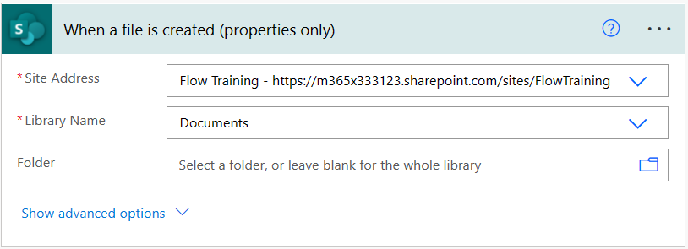
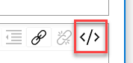
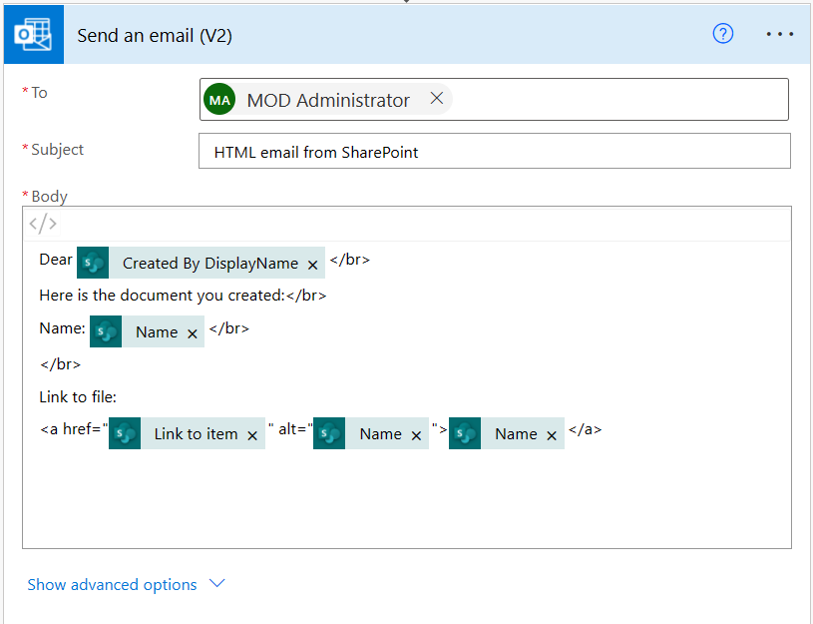
Lab 2 - Use HTML option in mail actions (SharePoint)
Follow along
Create new “Automate cloud flow” named “HTML Email” and select "When a file is created (SharePoint)“ trigger
Connect Documents library in your FlowTraining site
Add action “Send an email (V2)”
To: Your O365 email address
Subject: “HTML email from SharePoint”
Body – click “</>” to enter code view and add content like below replacing red parts with dynamic content from “When an item is created” step
Dear [Created by Displayname] </br>​
Here is the document you created:​</br>
Name: [Name] </br>
</br>
​ Link to file:
<a href="[Link to item]" alt="[Name]"​>[Name]</a>
Save and test the Flow by selecting “Manually”

Slide 21
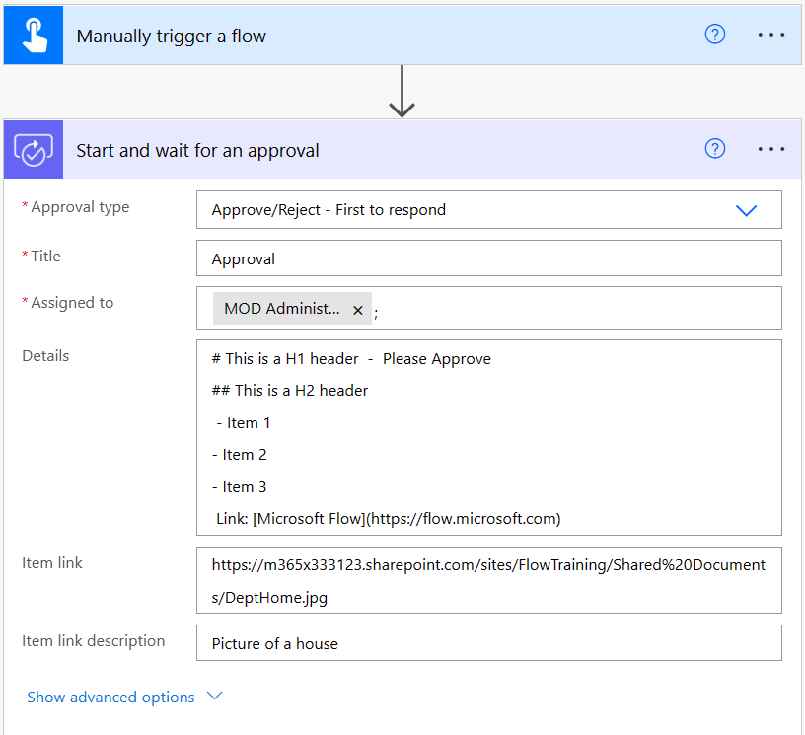
Lab 3 - Approval vs email with options
Follow along
Create new “Instant cloud flow” with name “Approval vs email with options” and select “Manually trigger a flow” trigger
Add action "Start and wait for an approval"
Approval type: "Approve/Reject - First to respond“
Title: Approval
Assigned to: Your O365 mailbox in the tenant
Details:
# This is a H1 header - Please Approve
## This is a H2 header
- Item 1
- Item 2
- Item 3
Link: [Microsoft Flow](https://flow.microsoft.com)
Item link: https://YOURTENANTNAME.sharepoint.com/sites/FlowTraining/Shared%20Documents/DeptHome.jpg
Item link description: "Picture of a house“
Notes:
Documentation :
Use Markdown in Microsoft Flow approval requests : https://docs.microsoft.com/en-us/flow/approvals-markdown-support

Slide 22
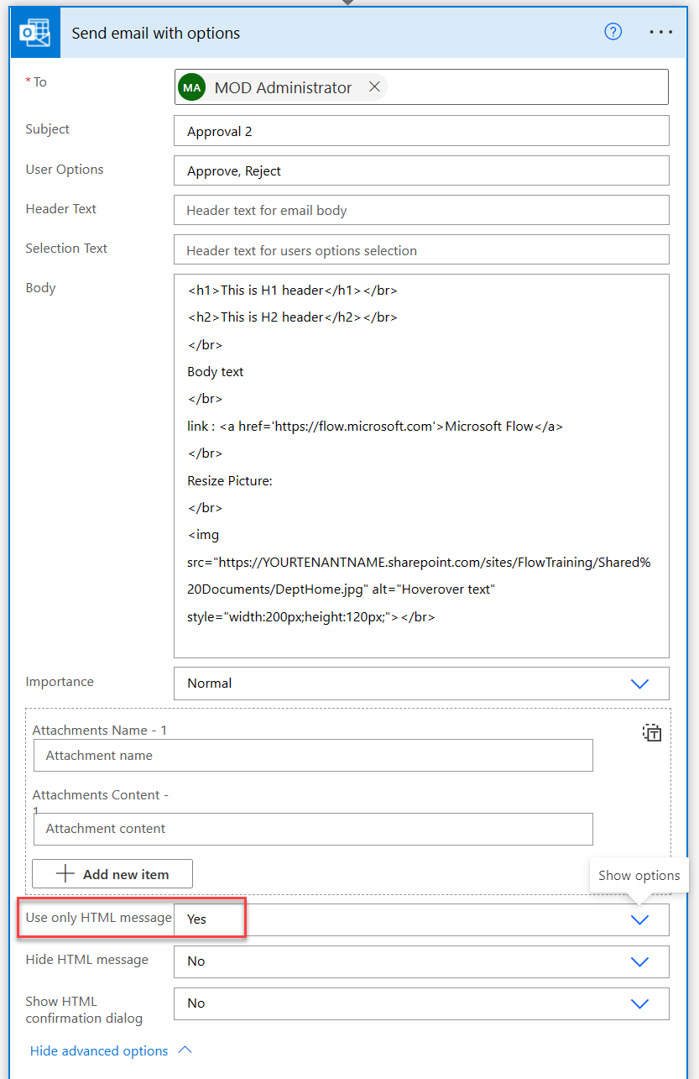
Lab 3 - Approval vs email with options
Follow along
Using same Flow add new action “Send an email with options”
To: Your O365 account email address
Subject: Approval 2
User Options: Approve, Reject
Body:
<h1>This is H1 header</h1></br>
<h2>This is H2 header</h2></br>
</br>
Body text
</br>
link : <a href='https://flow.microsoft.com'>Microsoft Flow</a>
</br>
Resize Picture:
</br>
<img src="https://YOURTENANTNAME.sharepoint.com/sites/FlowTraining/Shared%20Documents/DeptHome.jpg" alt="Hoverover text" style="width:200px;height:120px;"></br>
Save and test Flow by selecting “Manually”
Approve / Reject the Approval task and select either Approve or Reject in email send by Send an email with options action
See the value of SelectedOption which should be the choice you selected
Notes:
Documentation :
Use Markdown in Microsoft Flow approval requests : https://docs.microsoft.com/en-us/flow/approvals-markdown-support

Slide 23
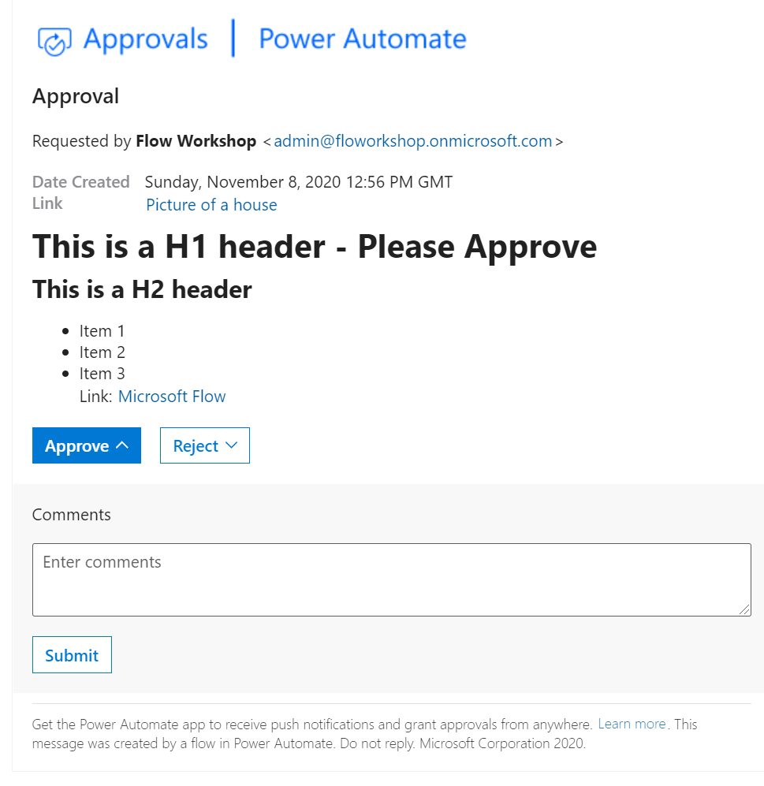
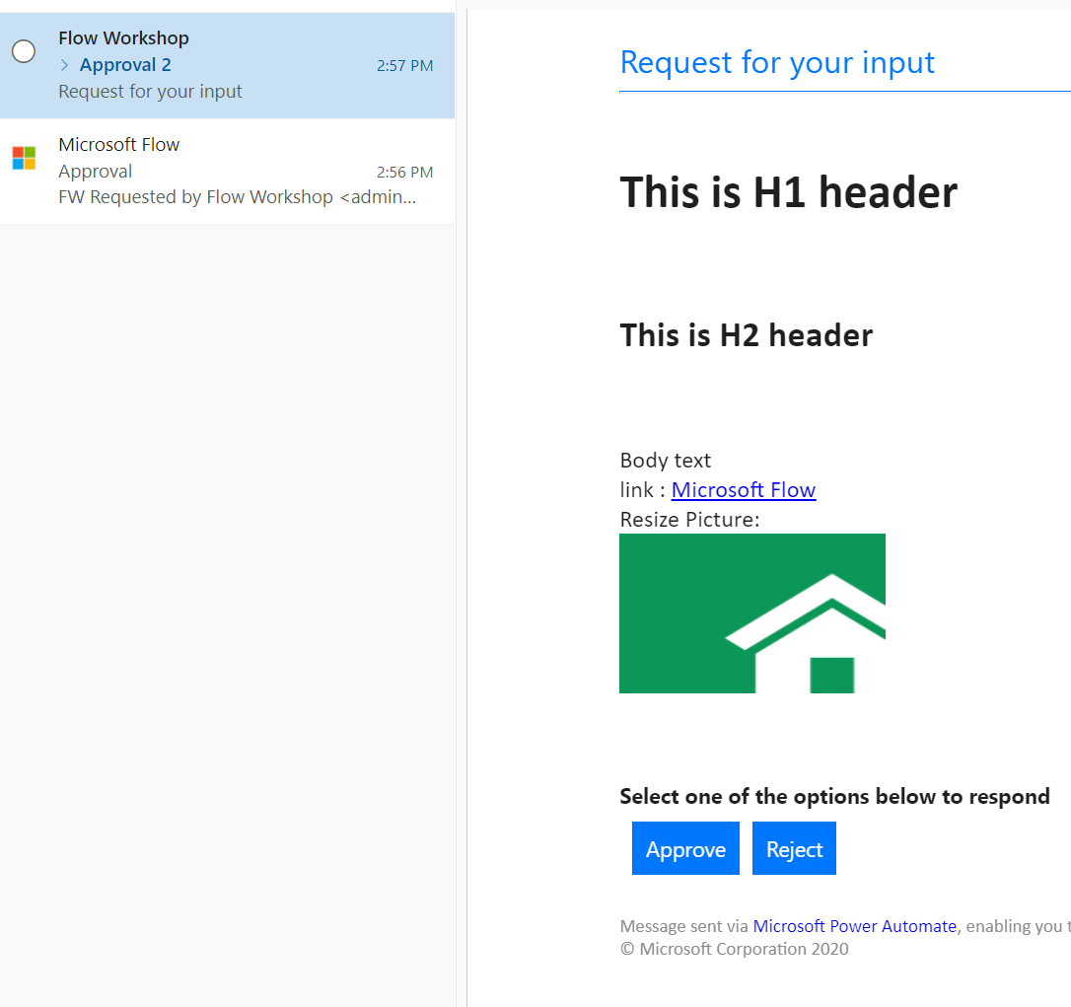
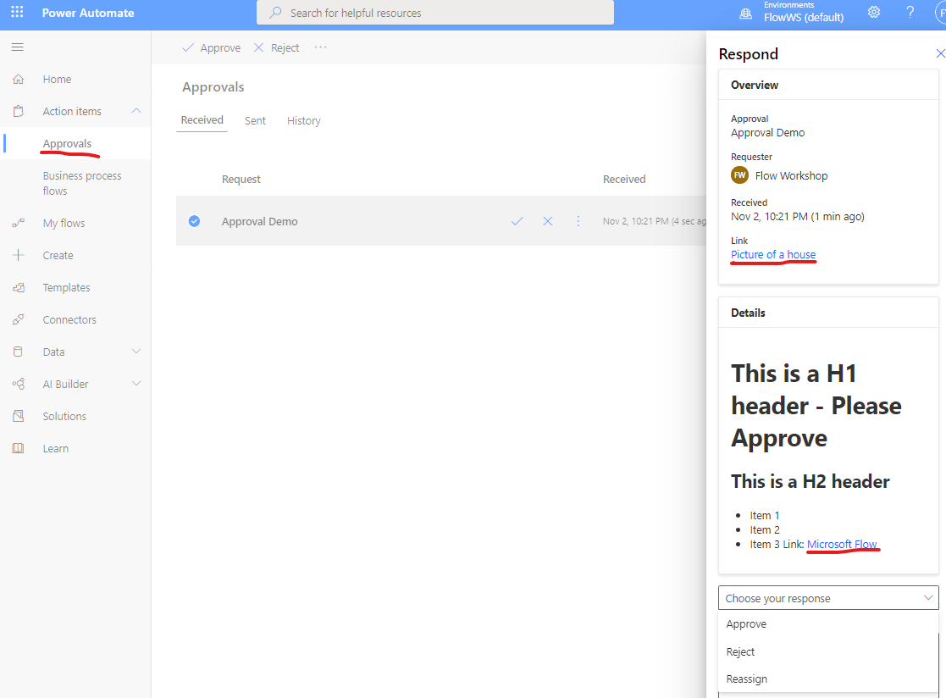
Lab 3 - Approval vs email with options
Follow along
Notes:
Documentation :
Use Markdown in Microsoft Flow approval requests : https://docs.microsoft.com/en-us/flow/approvals-markdown-support

